Slide 1
Convolutional Neural Networks
A brief introduction of an AI model with its application in healcare

Slide 2
Table Of Contents
01
02
03
Introduction
Workflow
Potential

Slide 3
01
Introduction

Slide 4

A state-of-the-art method
With the advancement of AI, now machine can be used for classifying objects. And, CNN is one of the most powerful in image recognition.
(Image source: Google Developer)
Notes:
Convolutional Neural Networks (CNNs) are a class of deep learning models primarily designed for processing structured grid data, such as images. Inspired by the visual cortex of animals, CNNs excel at identifying patterns and features in visual data through a hierarchical approach. By utilizing convolutional layers, pooling layers, and fully connected layers, CNNs can learn to extract increasingly complex features from raw input images.
The potential of CNNs is vast and transformative. They have revolutionized fields like computer vision, enabling applications such as image classification, object detection, and facial recognition. Beyond images, CNNs are also making strides in areas like video analysis, natural language processing, and medical image diagnosis. Their ability to automatically learn features from data reduces the need for manual feature engineering, making them highly efficient for large-scale tasks.
As research and technology continue to advance, the potential of CNNs expands, paving the way for innovations in autonomous systems, augmented reality, and beyond. The integration of CNNs with other technologies, such as reinforcement learning and generative models, further amplifies their capabilities, making them a cornerstone of modern artificial intelligence.

Slide 5
02
Workflow

Slide 6
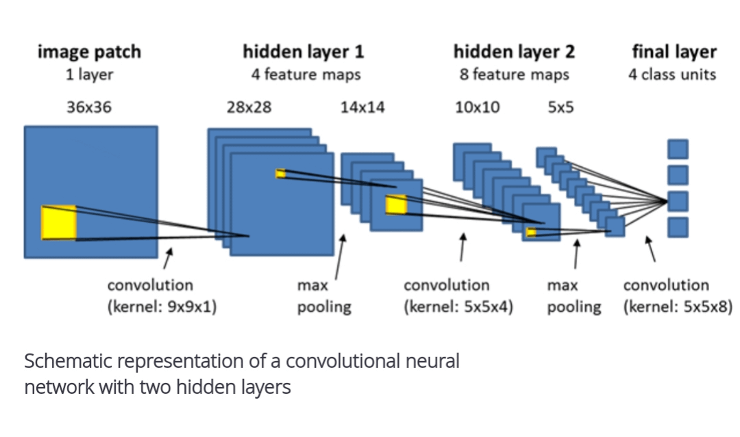
(Image source: Researchgate.net)

Slide 7
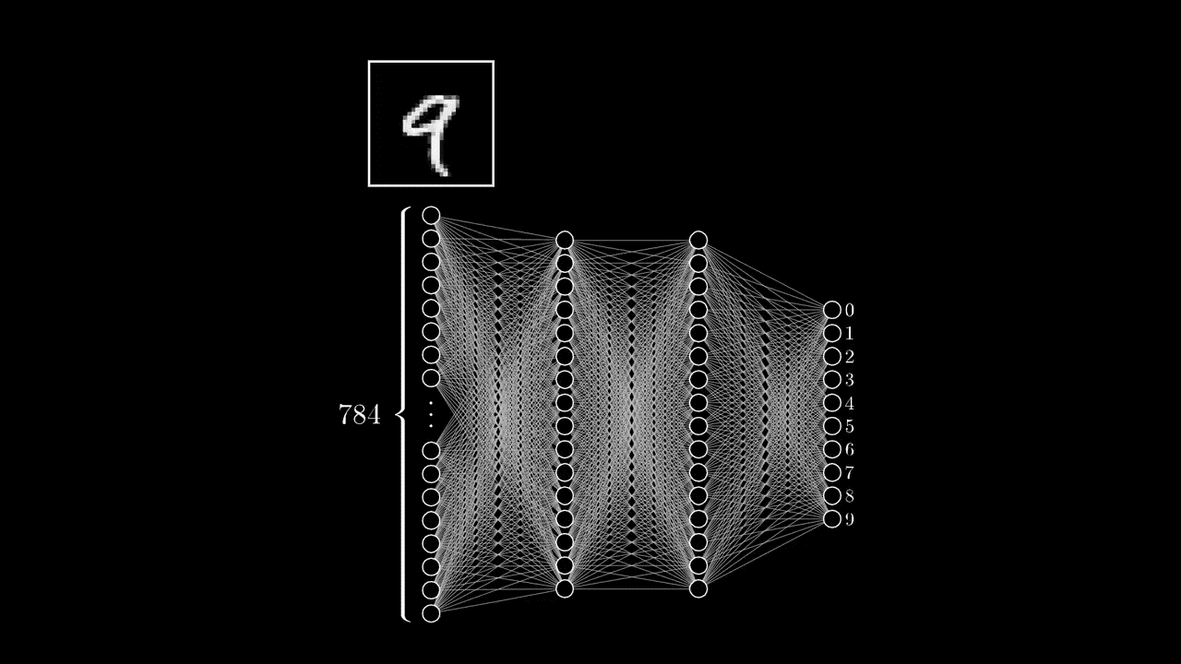
The neural network process
(video source: https://www.youtube.com/watch?v=IHZwWFHWa-w)
Notes:
The general workflow of the neuron network for classfication

Slide 8
03
Potential

Slide 9
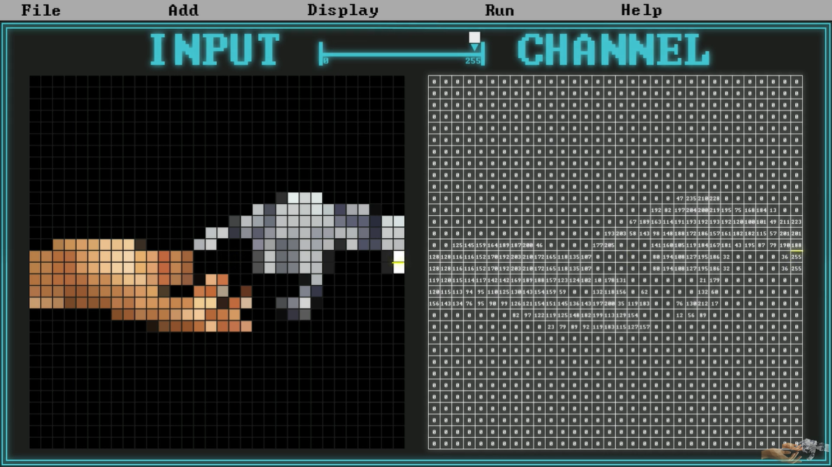
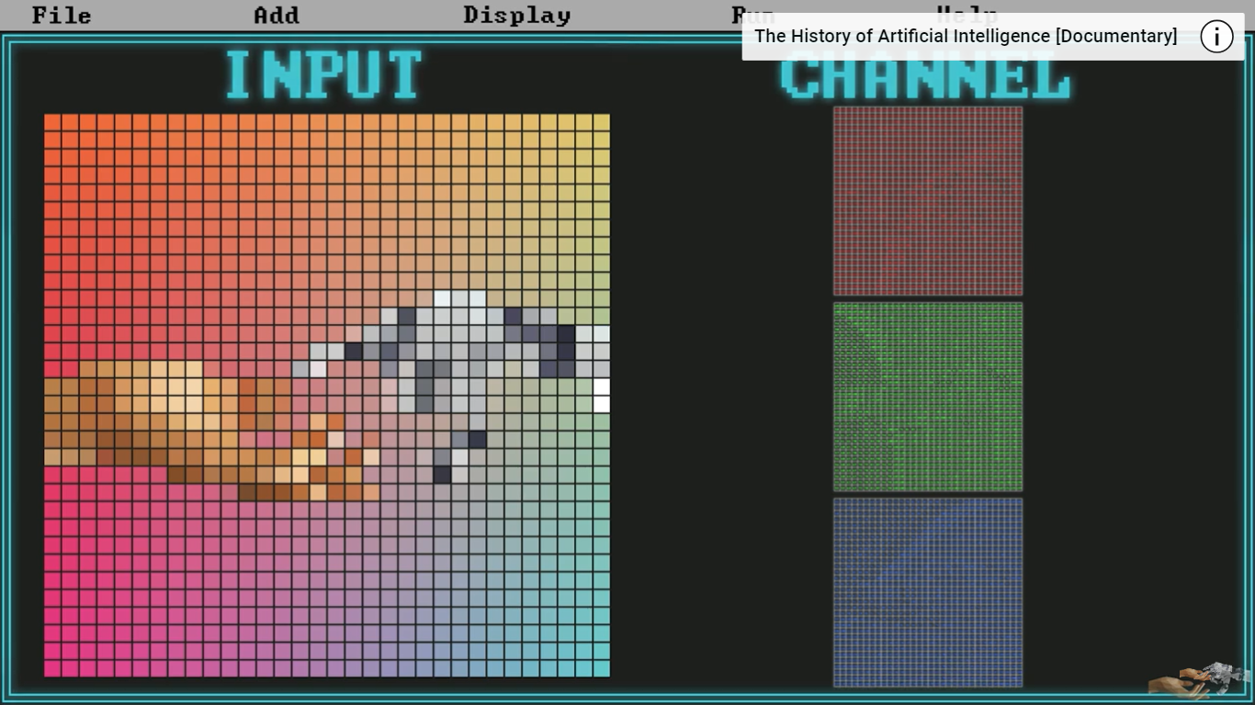
The input layer
(Image source: https://www.youtube.com/watch?v=pj9-rr1wDhM)
Notes:
For classification, the input layer receives an image, that is made up of tiny dots called pixels. Each pixel has colors.
The CNN starts by taking the picture and looking at it. The picture gets turned into a big list of numbers that represent the colors of the pixels.

Slide 10
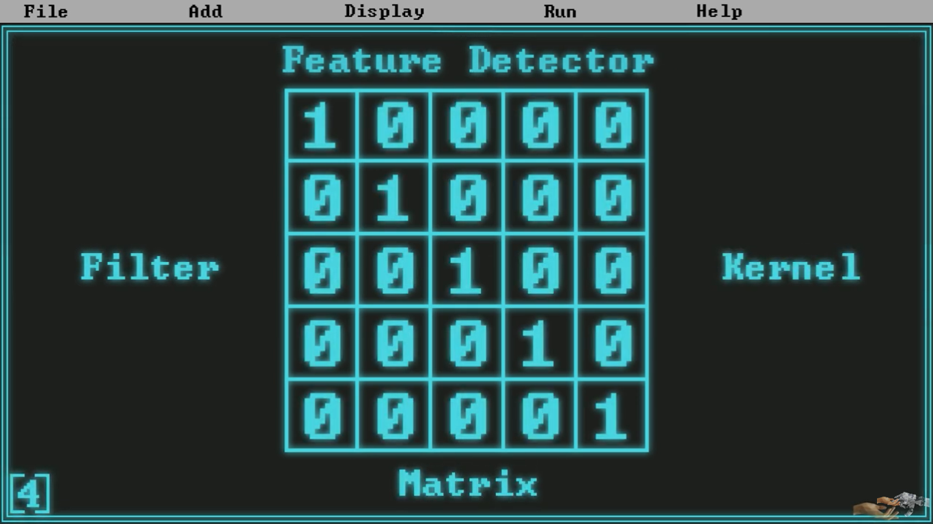
The convolutional layer
(source: https://www.youtube.com/watch?v=pj9-rr1wDhM)
To extract features from the image, the convolutional layer looks at small parts of the image and identify patterns like edges, shapes, or textures.
Notes:
Little Windows:
Now, imagine looking at your picture through a small window (like a magnifying glass). This window is in a matrix form. The CNN has one or more these little windows (called filters) that slide over the picture.
As it moves, it performs a mathematical operation called convolution. This operation involves multiplying the values in the filter by the values of the pixels it’s currently covering, then summing those products to produce a single output pixel.
This process helps the CNN detect specific features (like edges, textures, etc.) in the image.

Slide 11
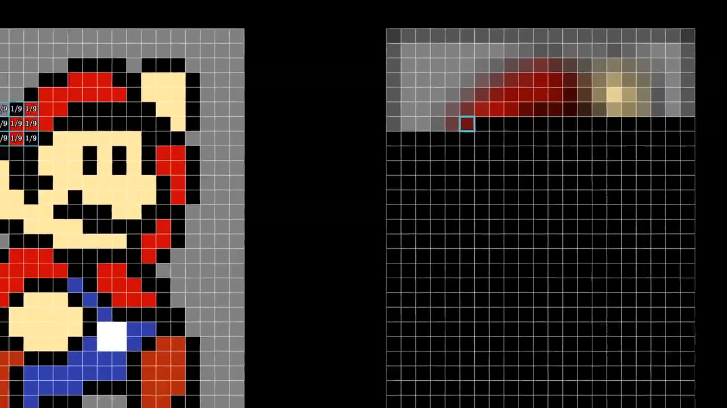
The convolutional layer
(video source: https://www.youtube.com/watch?v=KuXjwB4LzSA&t=594s)
Notes:
As the filter slides across the entire image, it generates a new output called a feature map, which highlights the features detected by that filter.
Purpose: The convolutional layer's job is to extract features from the image. It uses filters (or magnifying glasses) to look at small parts of the image and identify patterns like edges, shapes, or textures.

Slide 12
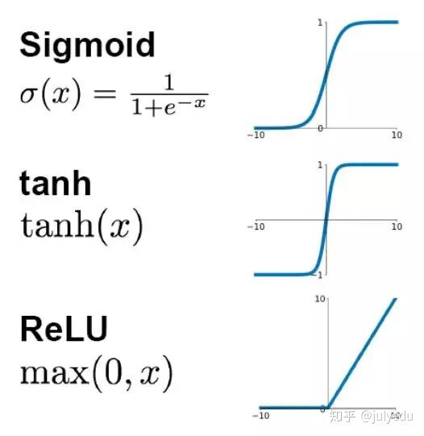
The activation layer
Activation Layer Is Like a Helper
It turns on (or lights up) the patterns it finds exciting and ignores the boring ones.
(Image source: DeepLearningAI)
Notes:
Imagine you're trying to build a really cool robot that can recognize different toys. But to do that, the robot needs to learn a lot about what toys look like.
From the convolutional leyer, we see that the robot uses special "magnifying glasses" (called filters) to look at different parts of a toy. Each magnifying glass helps it see specific details, like colors or shapes.
Activation Layer Is Like a Helper: After the robot looks at a toy through the magnifying glass, it needs a helper to decide what to do with what it sees. This helper is called the activation layer.
Making Decisions: The activation layer takes the information from the magnifying glass and helps the robot decide which features are important. For example, if the robot sees something blue and round, the helper will say, "Hey, that could be a ball!" But if it sees something dark, it might say, "That's not important; ignore it."
Learning Patterns: With the help of the activation layer, the robot gets better at recognizing toys because it learns to focus on the important details and ignore the unimportant ones.
=> Purpose: The activation layer’s job is to add non-linearity and help the network make decisions about the features it just found. It turns on (or lights up) the patterns it finds exciting and ignores the boring ones.

Slide 13
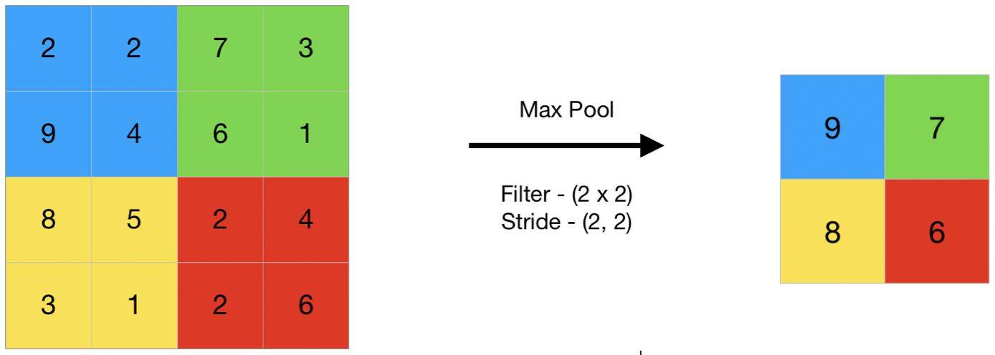
The pooling layer
How to simplify the image more?
(image source: geeksforgeeks)
Notes:
Here, we still want to simplify the image. So the pooling layer is used to reduce the spatial dimensions of the feature map produced by the convolutional layer. This helps to decrease the amount of computation and parameters, and introduces some translational invariance.
Some pooling layers:
Max pooling
Average pooling
Fractional pooling

Slide 14
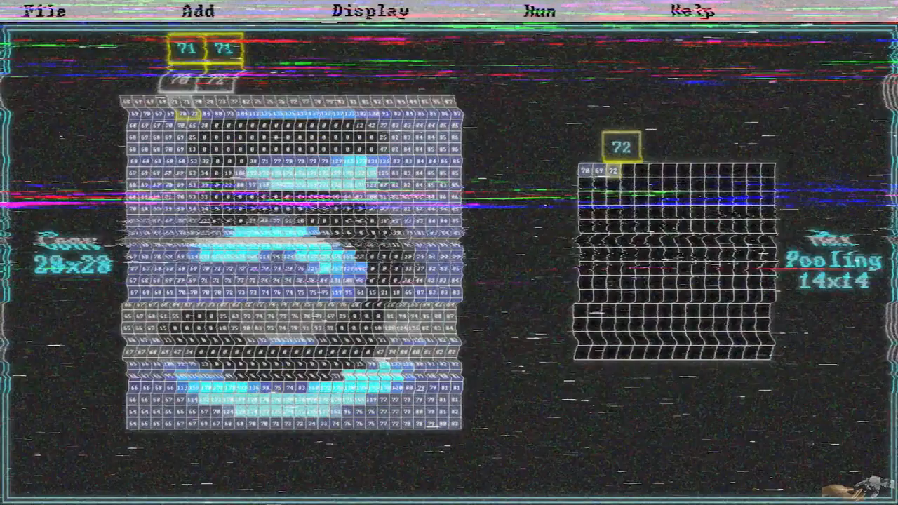
The pooling layer
(video source: https://www.youtube.com/watch?v=pj9-rr1wDhM )
Notes:
Purpose: The pooling layer reduces the spatial dimensions of the feature map produced by the convolutional layer. This helps to decrease the amount of computation and parameters.

Slide 15

The flattening layer
The Flattening layer transforms a multi-dimensional input (like a 2D feature map) into a one-dimensional array
(Image source: SuperDataScience)

Slide 16
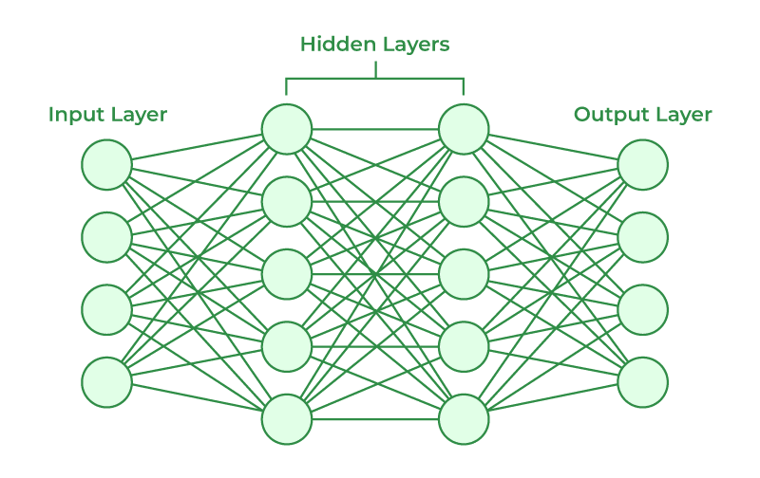
The fully connected layer
The fully connected layer is a neural network
(Image source: geeksforgeeks)

Slide 17

The fully connected layer
$$f= σ\left(\sum_{i}{w_{i}.a_{i}}+b\right), w:weight, a:neuron^{′}s value, b:bias$$
Each connection between neurons has a weight that adjusts how much influence one neuron has on another. There’s also a bias, which allows the model to make adjustments independently of the input.

Slide 18
Forward Propagation
Loss Function
Back Propagation
Notes:
The way it works:
Forward Propagation: When data is fed into the network, it moves from the input layer through the hidden layers to the output layer. Each neuron processes the data, applies weights and biases, and passes the result through an activation function. This process continues until the output layer produces a result.
Loss Function: After the output is produced, the network evaluates how accurate its prediction is using a loss function. This function quantifies the difference between the predicted output and the actual result (like the correct label in a classification task).
Backpropagation: If the prediction is incorrect, the network adjusts itself. Backpropagation is the process of calculating the gradient of the loss function and updating the weights and biases accordingly to minimize the error. This is done using optimization algorithms like gradient descent. Starting from the output layer, the model calculates the gradient (slope) of the loss function with respect to each weight using the chain rule of calculus. This tells the model how much to change each weight to reduce the loss.

Slide 19
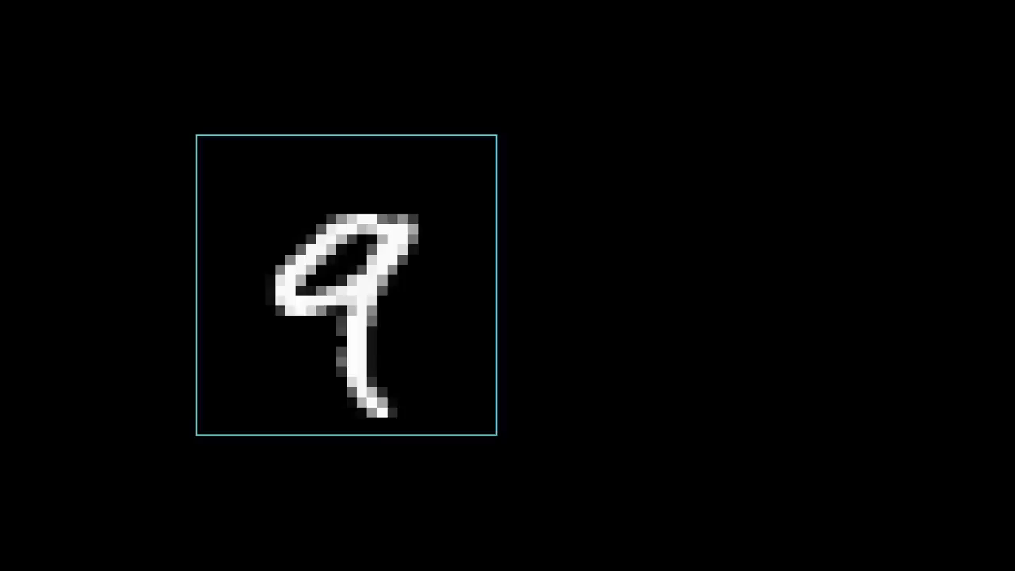
The neural network process
(video source: https://www.youtube.com/watch?v=IHZwWFHWa-w)
Notes:
How the image is presented in the first layer

Slide 20
The neural network process
(video source: https://www.youtube.com/watch?v=IHZwWFHWa-w)
Notes:
The general workflow of the neuron network for classfication

Slide 21
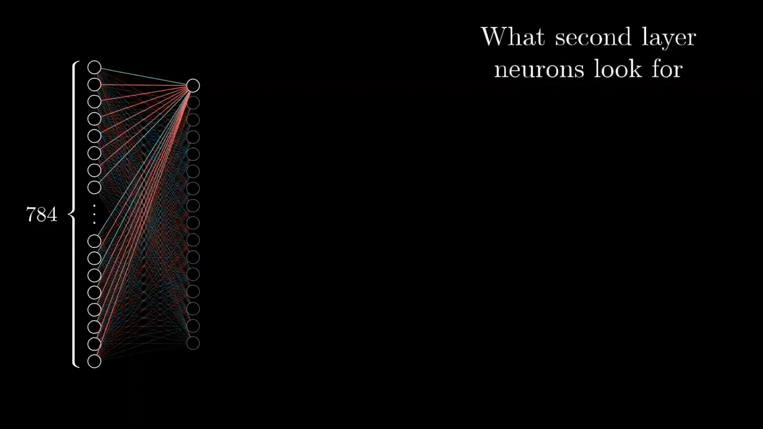
The neural network process
(video source: https://www.youtube.com/watch?v=IHZwWFHWa-w)
Notes:
How the neuron connects to each other

Slide 22
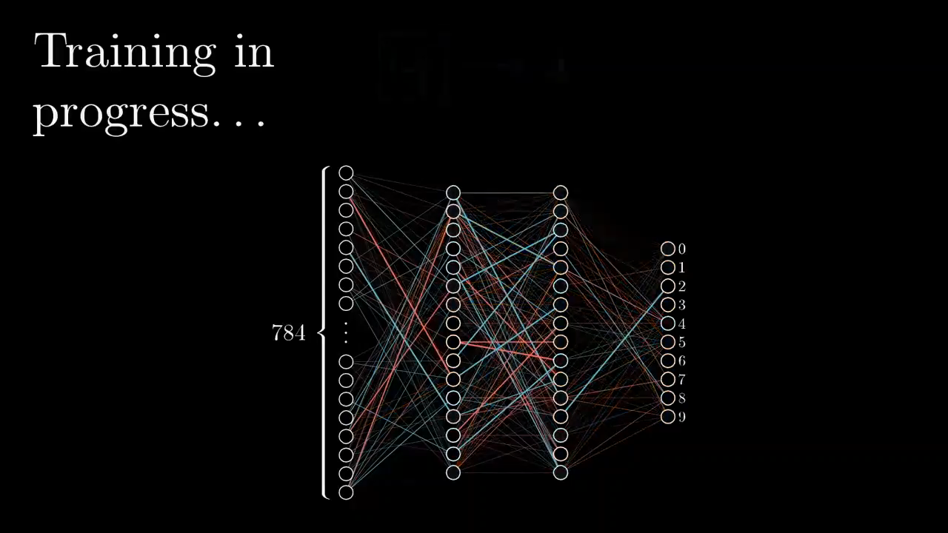
The neural network process
(video source: https://www.youtube.com/watch?v=Ilg3gGewQ5U)
Notes:
Back-propagation

Slide 23
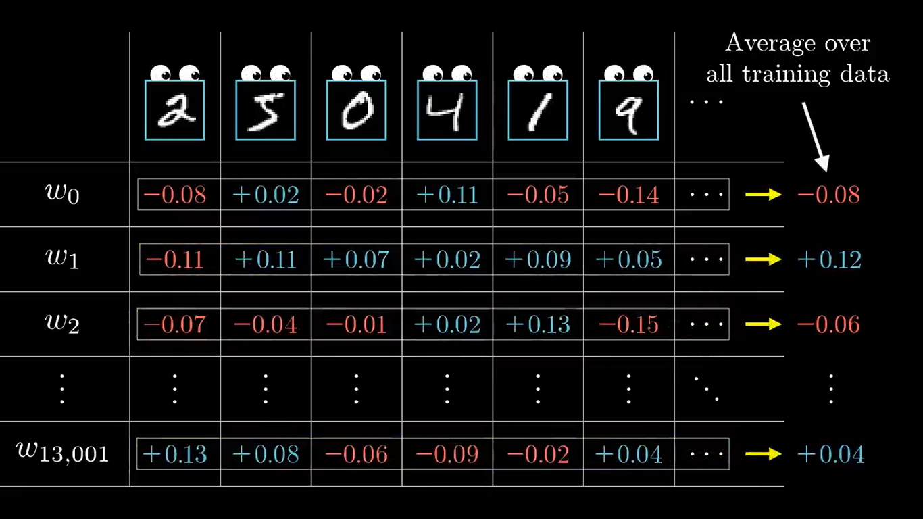
The neural network process
(Image source: https://www.youtube.com/watch?v=Ilg3gGewQ5U)

Slide 24
Thanks for listening

